Slide 1


Boulder Tea Brewers
Reem Alkheraiji – Margo Kmetz – Chloe Craig-Lotito – Megan Shaull

Slide 2
Profit
Before Maximization
After Maximization
$3,208.97
$6,773.42
More than double the amount, with a more than %111 increase!

Slide 3
We have used every gram of ingredient in our inventory narrowing our slack to exactly
0g !
Optimization Reports
By using all our ingredients we save $5,509.06
To add, we were given a $1000 budget, and we still have more than $174 left.

Slide 4

BUT HOW?

Slide 5

INTRODUCING OUR NEW DELICIOUS TYPES OF TEA!
- Cinnabon Heaven - Calmness - Cold Reliever - Tuity Fruity
- Sweet & Spicy - Floral
- Mint Magic - Lemon Mint
- Rare Combo - Sunshine
- Sweet Peppermint - Spicy Lemon
- Fitness

Slide 6
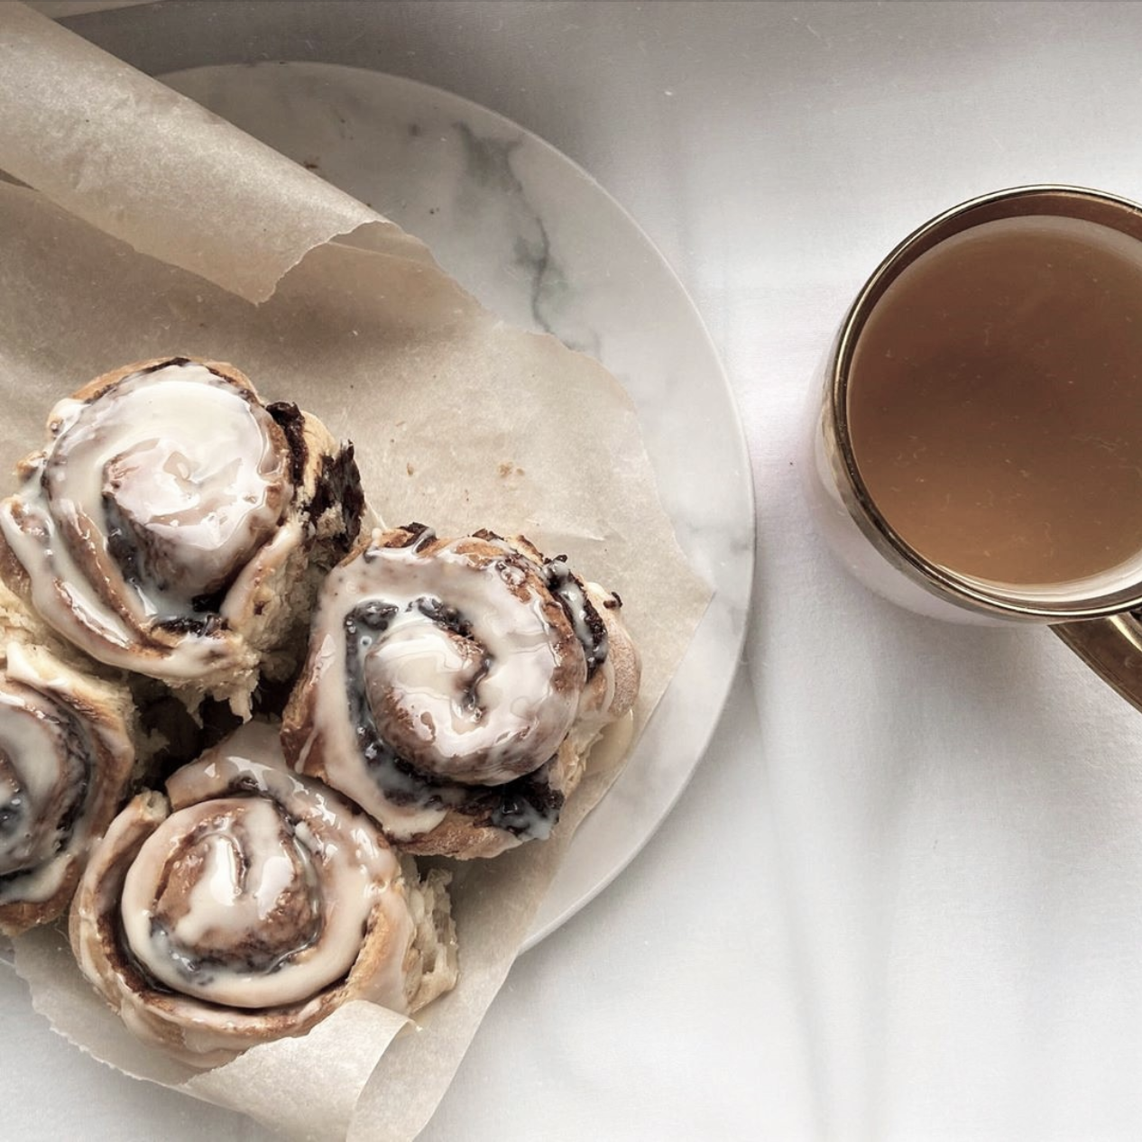
Cinnabon Heaven
Cinnabon Heaven generates a profit of
$3.72 per box
As a result, it is ranked
1st
Highest profit among all teas! It holds this title with Peppermint Patty tea which shares the same profit.

Slide 7

Tuity Fruity
Tuity Fruity is popular among fruit fans, fitness enthusiasts, and celebrities.
This can be attributed to its photogenic looks, great taste, and the ability to serve it both hot and cold!
It generates a profit of
$3.04 per box
As a result, it is ranked
Highest profit among all teas!
HOT
COLD
2nd

Slide 8
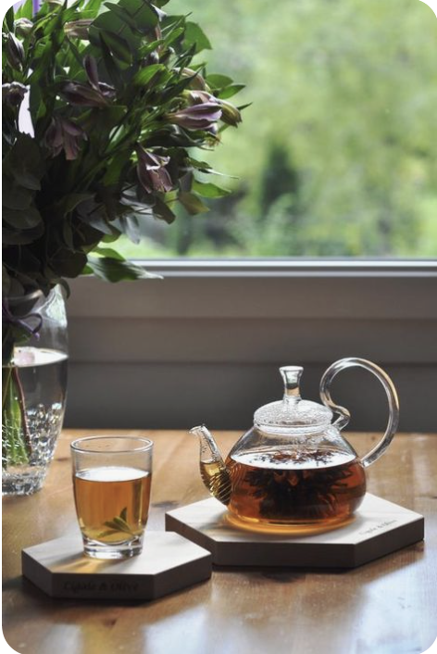
Cold Reliever
Since we are in the winter season and are in a middle of a COVID pandemic, we anticipate Cold Reliver to become one of our best sellers. It is the best drink and healing solution for colds and it could also help ease some COVID symptoms!
We believe Cold Reliever should be the highlight of our upcoming advertisements in order to maintain our competitive advantage.

Slide 9
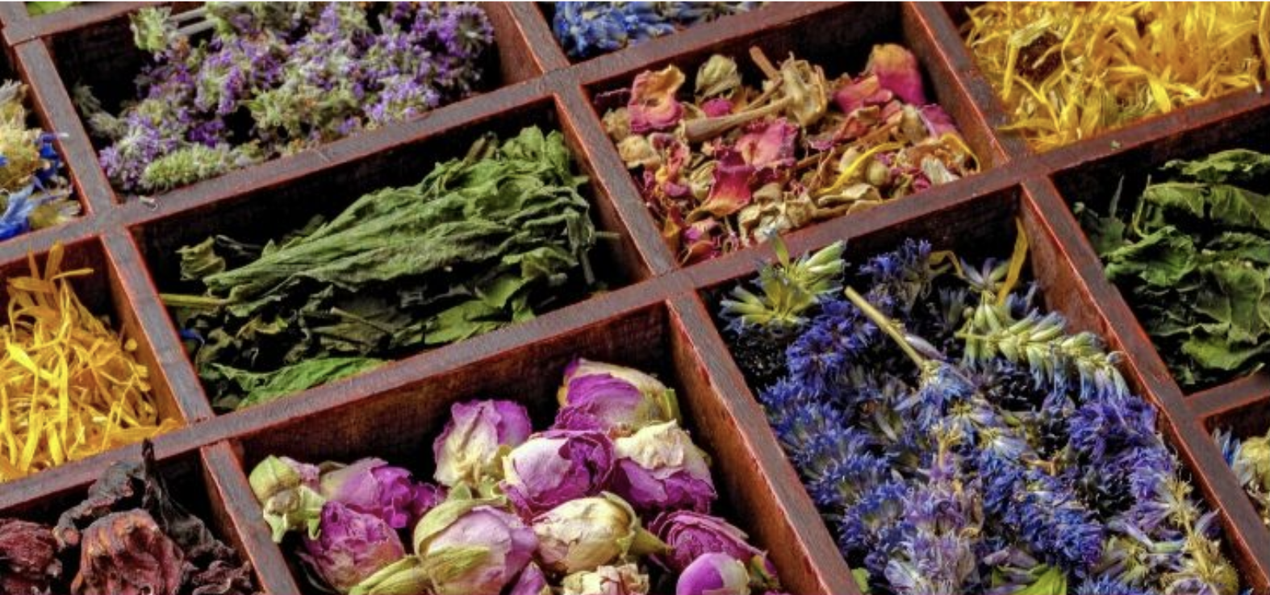
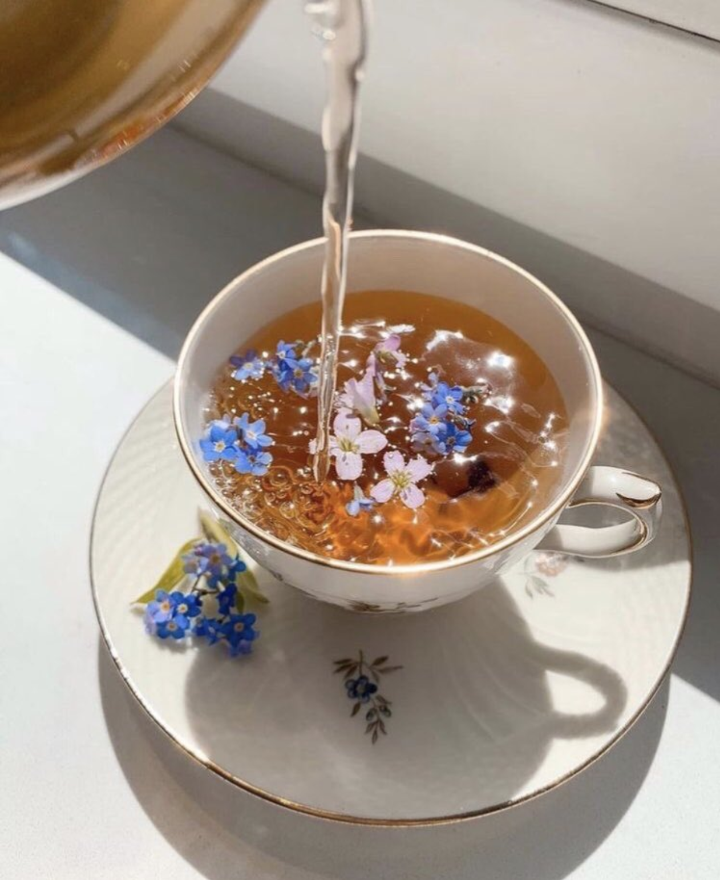
floral
Floral is the new tea we see as
“The Hidden Gem”
It is made of most of our floral ingredients and we believe it has a high potential of success similar to Tuity Fruity, due to its photogenic/colorful look and delicious taste.
For that, we would like our marketing team to put Floral tea under the spotlight both in advertisements and in e-commerce.

Slide 10
Solver model
Target Cell (Max Profit):
= SUMPRODUCT(# of Boxes, Profit of Each Box)
Changing Cells (Number of Boxes)
Constraints:
Number of Boxes (Changing Cells) must be Integers
Amount Used <= Amount Available
Amount Produced >= 200 (Min Demand)
Non-negative Numbers

Slide 11
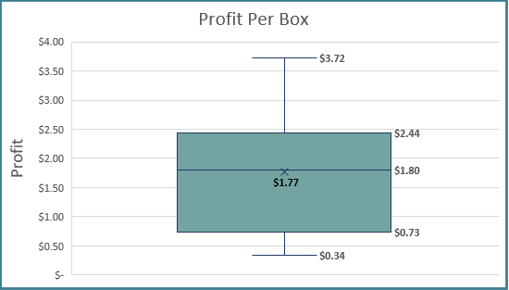
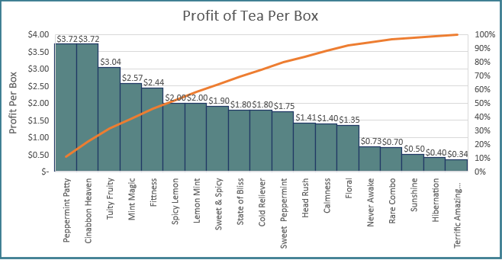
Tea analysis
According to our data, our tea profit per box range from $0.34 to $3.72 with a mean of $1.77
The teas with the highest profit are Peppermint Patty and Cinnabon Heaven while Terrific Amazing Morning lends the lowest profit.
As for the number of boxes, we are making mostly even numbers across the board by meeting or exceeding customer demand.

Slide 12
Ingredient analysis
At 6,000 grams, Cinnamon was the ingredient we purchased and sold the most and used in 9 different types of tea
The only other ingredient that was used in 9 different types of tea was Lemon Grass which we bought 2,326 grams of and used 32,836 grams
Mango was the ingredient that was used the least amount of at 4,900 grams, and we only bought 100 grams of this ingredient

Slide 13
Descriptive Stats
We can employ a Project Manager to lead the team in charge of the new teas project. The team could keep track of the descriptive statistics, analyze them, and update them when we change anything to see if we are improving by making that change or if we shouldn't make the change.
Profits of 1 box across all tea types
Amount purchased of individual ingredients
Cost of 1 box across all tea types
Profit
Mean | 1.766842
Standard Error | 0.233431
Median | 1.8
Mode | 3.72
Standard Deviation | 1.017503
Sample Variance | 1.035312
Kurtosis | -0.30874
Skewness | 0.461444
Range | 3.38
Minimum | 0.34
Maximum | 3.72
Sum | 33.57
Count | 19
Cost
Mean | 3.733158
Standard Error | 0.233431
Median | 3.7
Mode | 1.78
Standard Deviation | 1.017503
Sample Variance | 1.035312
Kurtosis | -0.30874
Skewness | -0.46144
Range | 3.38
Minimum | 1.78
Maximum | 5.16
Sum | 70.93
Count | 19
Amount Purchased (g)
Mean | 1481.786
Standard Error | 518.585
Median | 189
Mode | 100
Standard Deviation | 1940.367
Sample Variance | 3765026
Kurtosis | 0.510894
Skewness | 1.216204
Range | 5994
Minimum | 6
Maximum | 6000
Sum | 20745
Count | 14
- Avg. Profit of just old teas is $1.40, Avg. Profit of just new teas is $1.94
Very large difference between the mean ->
and median due the large range and standard deviation
Approximately
<- symmetrically skewed ->
Highly positively ->
skewed
- Range of Profits is the same as Cost. However, the min and max of profits are both lower than cost

Slide 14
Z – Scores
Tea | Total Costs | Z-Score
Never Awake | $ 1,211.58 | 1.997115554
Peppermint Patty | $ 356.00 | -1.8037834
Head Rush | $ 818.00 | 0.248643393
Hibernation | $ 1,020.00 | 1.146024806
State of Bliss | $ 740.00 | -0.09787022
Terrific Amazing Morning | $ 1,032.00 | 1.199334593
Calmness | $ 820.00 | 0.257528357
Spicy Lemon | $ 700.00 | -0.27556951
Cold Reliever | $ 740.00 | -0.09787022
Sweet & Spicy | $ 720.00 | -0.18671987
Floral | $ 830.00 | 0.30195318
Lemon Mint | $ 735.00 | -0.12008263
Fitness | $ 612.00 | -0.66650795
Rare Combo | $ 960.00 | 0.879475871
Sunshine | $ 1,000.00 | 1.057175161
Sweet Peppermint | $ 750.00 | -0.0534454
Cinnabon Heaven | $ 356.00 | -1.8037834
Mint Magic | $ 586.00 | -0.78201249
Tuity Fruity | $ 492.00 | -1.19960582
The Z-score for the Never Awake tea is the highest of all the teas.
Cinnabon Heaven has the lowest Z-score below average.

Slide 15
We recommend our marketing team to put our new teas under the spotlight. Even though the new teas were mostly successful, we believe it has a higher potential and will help us maintain our competitive advantage.
We can develop an information system that notifies us when ingredients are close to getting out of stock to restock them in a timely manner.
We should have a special focus on Cinnamon since it is the ingredient we use the most.
Professional Recommendations

Slide 16
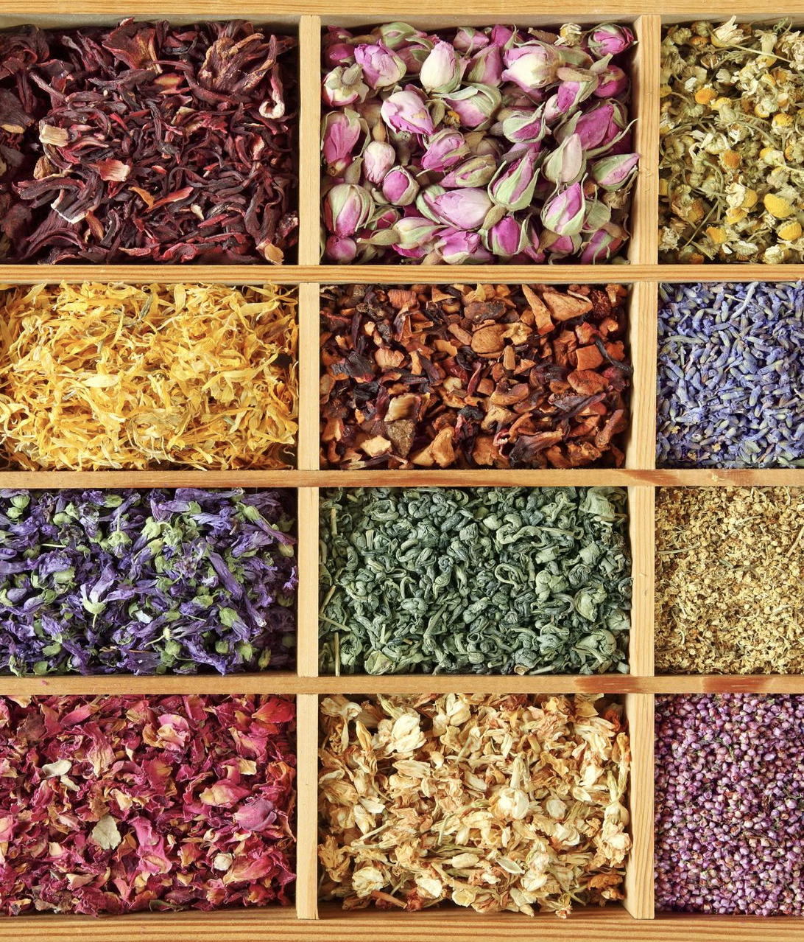
Thank you for watching

